Slide 1
Heat Transfer Presentation
An improved lumped analysis for transient heat conduction by using the Polynomial Approximation method.

Slide 2
Team Members Group -5
Ravi Joshi(B20ME060)
Shivam Verma (B20ME072)
Animesh Kumar Singh (B20ME012)
Ankit Daiya (B20ME013)
Garvit Meena (B20ME033)
Abhishek Singh (B20ME005)

Slide 3
INTRODUCTION
This paper uses the polynomial approximation method (PAM) to provide an enhanced lumped analysis of transient one-dimensional heat conduction in both cylindrical and Cartesian geometries.
Only very low Biot numbers can be used using the traditional lumped model, and it also cannot account for substantial temperature gradient in the region.
Based on the Polynomial Approximation Technique, a new, enhanced lumped parameter model is developed.
To verify the correctness of the model, a numerical solution to the issue using finite differences is employed as a control reference.
The current forecast and other analytical findings are found to be in good accord.

Slide 4

Simple Lumped Analysis Model
It is a technique for analysing transient heat conduction problems (also known as unsteady state heat conduction), and it greatly simplifies the study.
We may assume that the entire body (lump) is at the same temperature when internal conductance resistance is significantly smaller than exterior convective resistance. A straightforward lumped model is only appropriate for Biot values that are generally less than (0.1).
The solid in this basic model has a uniform temperature that is just a function of time since solid resistance may be neglected in compared to fluid resistance.
The Biot number criteria is around 0.1, and it only applies to small solids or materials with significant heat conductivity. In other words, moderate to low temperature gradients are covered by the simple lumped model.
The Simple Lumped equation is usually written in the following form:
where, is Dimensionless average temperature.
B_{i} is Biot Number and F_{o} is Fourier Number.

Slide 5

Improved Lumped Analysis Model
A new model with changes was implemented because of the limitations of the basic lumped analysis model.
In transient heat conduction, this approach is used to analyse the unsteady state, one-dimensional temperature distribution for long slabs, long cylinders, and spheres.
To arrive at a numerical solution to differential equation, polynomial approximation method is used.
For the duration of the heat transfer process, internal heat generation term (Q) is considered to remain zero.
The temperature fluctuates with respect to time and place in the heat conduction equation, which is of the transient kind.
For all geometries, it is assumed that the convective heat transfer coefficient is constant.
The modified lumped model equation for the average dimensionless temperature is as follows:

Slide 6

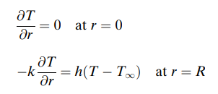


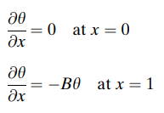


Mathematical Formulation
Unsteady state one dimensional temperature distribution of a long slab, long cylinder or sphere can be expressed by the following partial differential equation. h (Heat transfer coefficient) is assumed to be constant for all geometries.Where, m = 0 for slab, m = 1 for cylinder and m = 2 for sphere.
Boundary conditions and Initial conditions are:
Boundary conditions and above partial differential equation can be rewritten as:
So, here we uses dimensionless quantities because of the fact that it reduces the calculation and less mathematical operations will be done. Dimensionless parameters can be defined as:

Slide 7






Polynomial Approximation
One of the most simple and, in some cases, most accurate techniques for approximating partial differential equations is the polynomial approximation method.
There are two steps in the method:
1.) We choose a suitable polynomial with time-dependent coefficients in this step.
2.) We transform a partial differential equation into an integral equation in the second step. The average temperature is the dependent variable while time is the independent variable in this integral's transformation into an ordinary differential equation.
Boundary conditions:
FIRST STEP: Consider a regular series of parabolic partial differential equations shown below:
Differentiating and applying 2nd boundary condition
Now, after applying all boundary conditions in polynomial it becomes:
After integrating it we get:

Slide 8






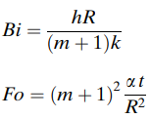

Polynomial Approximation
SECOND STEP: Average temperature for long slab, long cylinder and sphere can be written as:
m = 0 for slab, 1 and 2 for cylinder and sphere, respectively. After integration of basic equation i.e
We get: . .
After substitutions we finally get and
Now solving the equation we get:
Simple lumped equation, this equation should be expressed in terms of Biot and Fourier numbers:
And substituting in equation we get : this is improved lumped model.

Slide 9
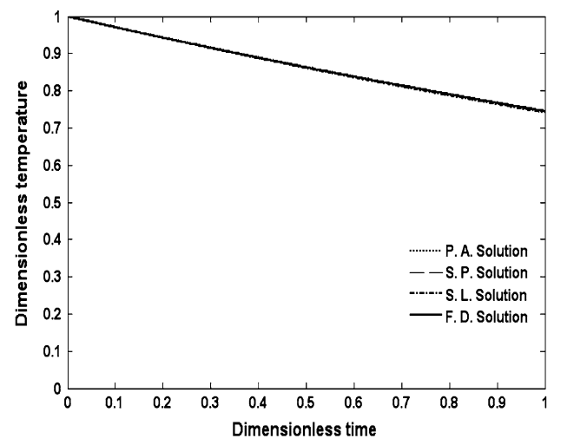
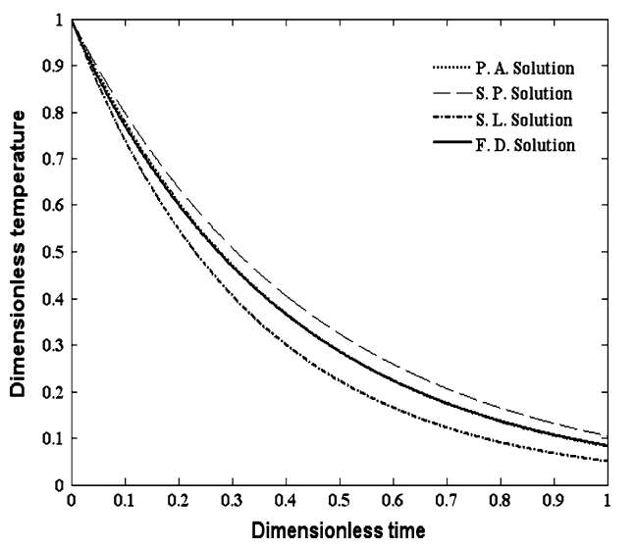
Results And Discussions
Figure 1 shows Average dimensionless temperature (θ) versus dimensionless time (τ) for sphere, B = 0.1, Bi = 0.1/3
Figure 2 Average dimensionless temperature (θ) versus dimensionless time (τ) for sphere, B = 1, Bi = ⅓.
This show that non-linearity in graph increases with increase in Biot number.
Figure-1
Figure-2

Slide 10
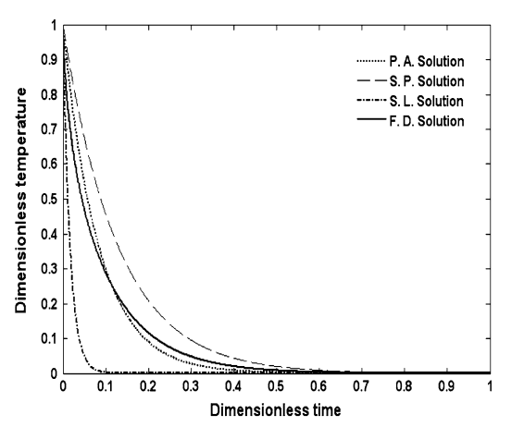
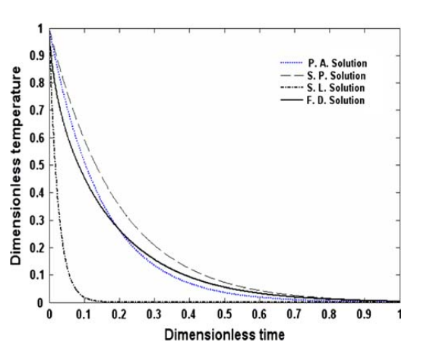
Figure-3
Figure-4
Figure 3 shows Average dimensionless temperature (θ) versus dimensionless time (τ) for sphere, B = 20, Bi = 20/3.
Figure 4 shows Average dimensionless temperature (θ) versus dimensionless time (τ) for cylinder, B = 20, Bi = 20/2.
The two graphs demonstrate that polynomial approximation, when compared to other methods, provides an average temperature value that is the closest to the result of the finite difference method.

Slide 11
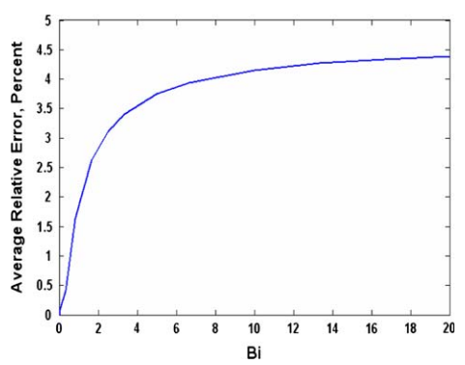
The graph shows the average relative error versus Biot number at T₀ = 2,000 K and T∞= 300 K
From figure we can notice that when Biot number increases, average relative error also increases.
Average Relative error tends to saturate at higher Biot number.
Average temperature varies w.r.t. position and time.
From the final expression of average temperature we can notice that there is an additional B_{i} in denominator, that implies that there will not be abrupt change in average temperature, compared to simple lumped model.
Figure-5

Slide 12
Conclusion
The improved lumped model can be implemented to calculate average temperature for higher values of Biot number.
The accuracy achieved in this model at higher values of Biot numbers is better than any recently developed lumped analysis model.
Even with higher Biot numbers, the average relative error is less than 5%.
The relationships may be used to many other engineering calculations and estimations.
As we implement dimensionless numbers in this method, it reduces the computational efforts and calculations.

Slide 13
Thank You !

